Slide 1
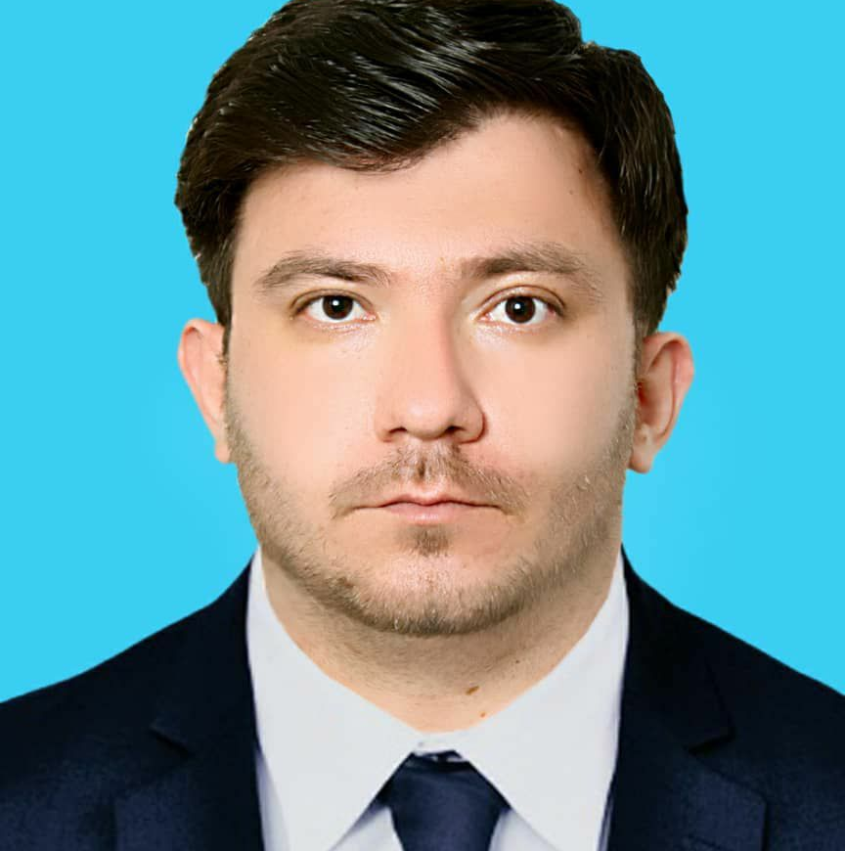
Sayed Hussain Mosawi
PH.D
Head of Medical Sciences
Research Center
Introduction to Research and its importance

Slide 2
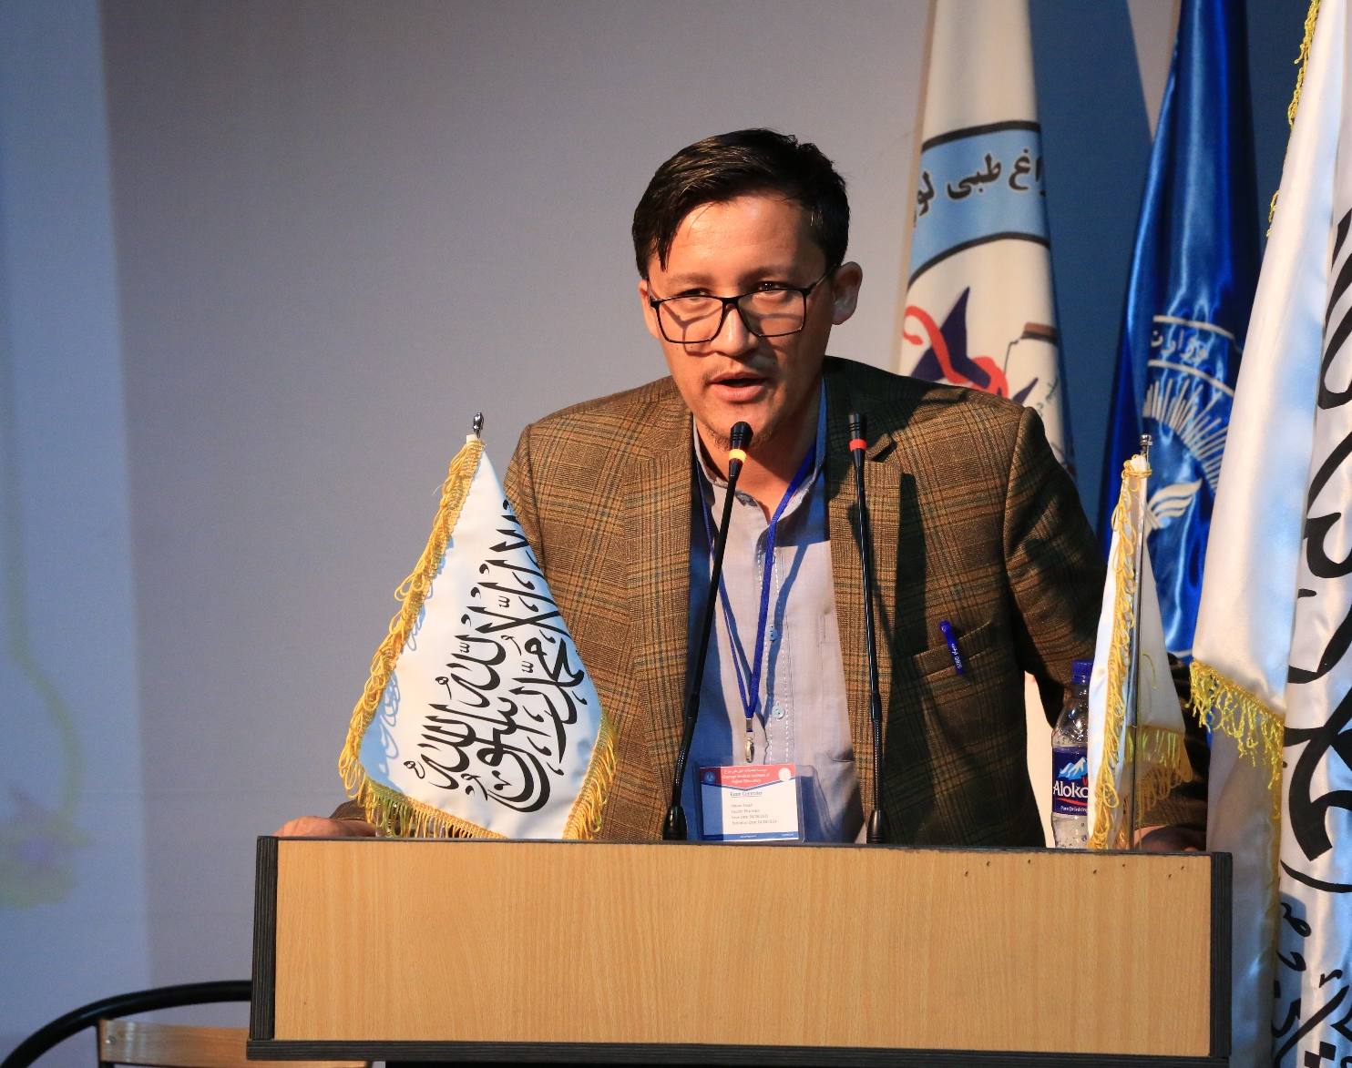
Hasan Ansari
PH.D
(Islamic Azad university central Tehran
Coordinator Advisory center of CMI
Qualities of good researcher

Slide 3
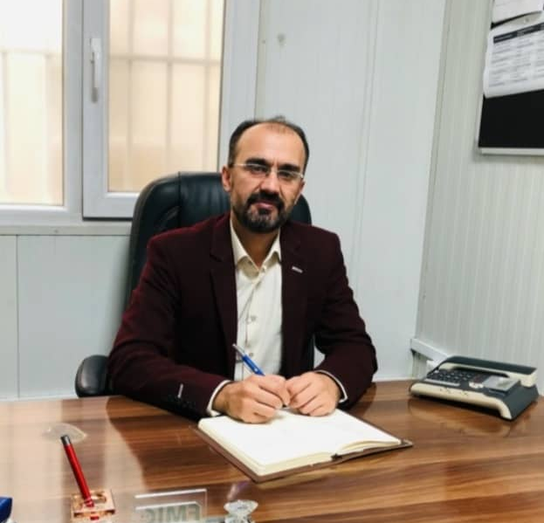
Sayed Murtaza Hofiani
MD, MPH
University of OPJS India/Academic and Research Manager of FMIC
Types of variables

Slide 4
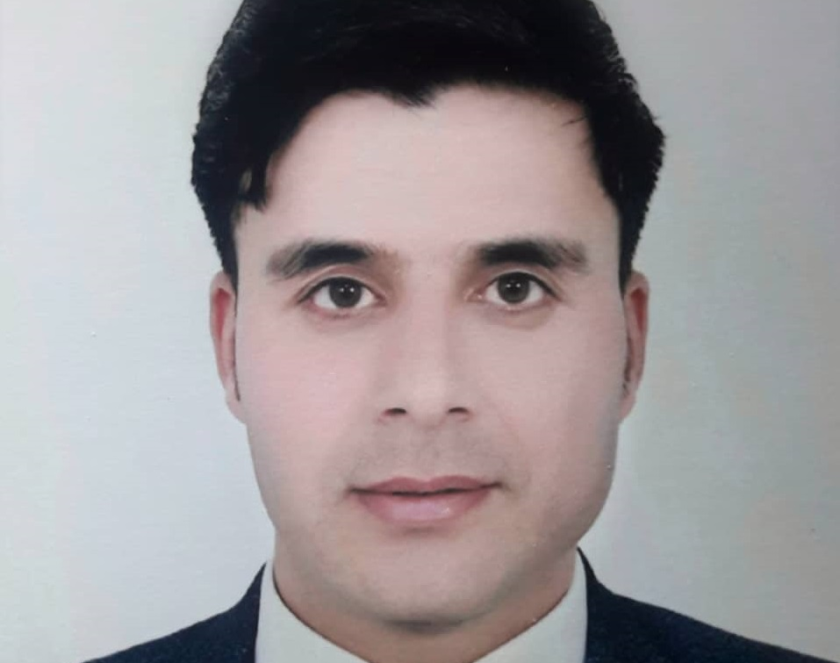
Mohammad Karim Abedy
M.Pharm
JU India, Head of QAAD and lecturer at CMI
Types of study

Slide 5
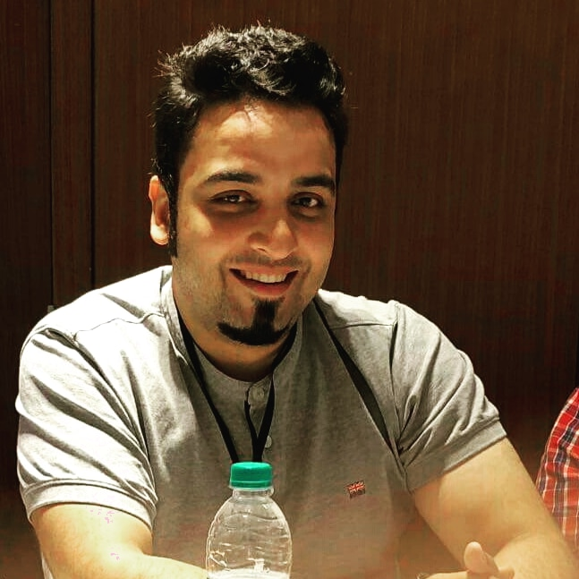
Haris Taheri
assistant professor and Master in public health
Assessing the Validity and reliability of Diagnostic and Screening tests:

Slide 6
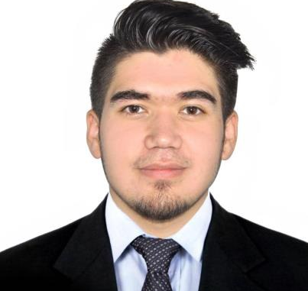
Shoaib Naeemi
Pharm.D
MLS, Field Epidemiology Mentor
The Normal Distribution

Slide 7
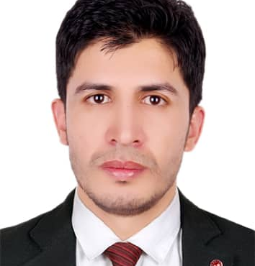
Sanaullah Safi
M.Pharm
SAU India, Head of Medical Sciences Research Center
BioRender , Plagiarism , Grammarly , Urkund

